Slide 1
Lake Photic Zone Temperature Across the Conterminous United States
Shivers, S.D.¹, Kreakie, B.J.², Milstead, W. Bryan², and Hollister, J.W.²
¹ ORISE Fellow, EPA Office of Research and Development, ACESD
² US EPA Office of Research and Development, ACESD
NALMS, November 14, 2019

Slide 2
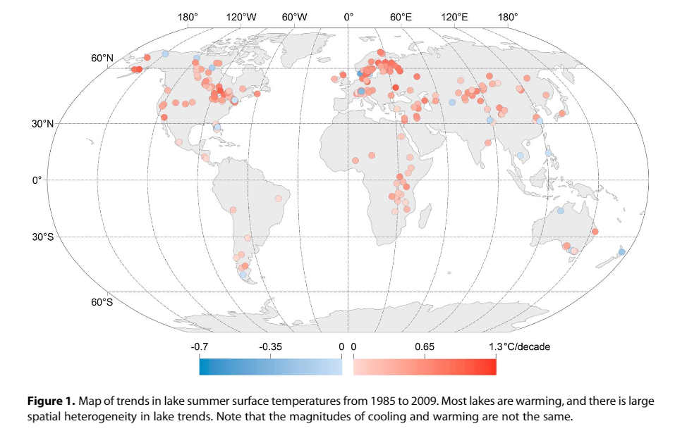
Introduction – Warming Lakes
Summer surface temperatures of lakes are increasing (0.34 °C/decade between 1985 and 2009)
Spatial heterogeneity in warming
Summer air temperature most important and consistent predictor
O’Reilly et al. 2015. Rapid and highly variable warming of lake surface waters around the globe. Geophysical Research Letters 42:10773-10781

Slide 3
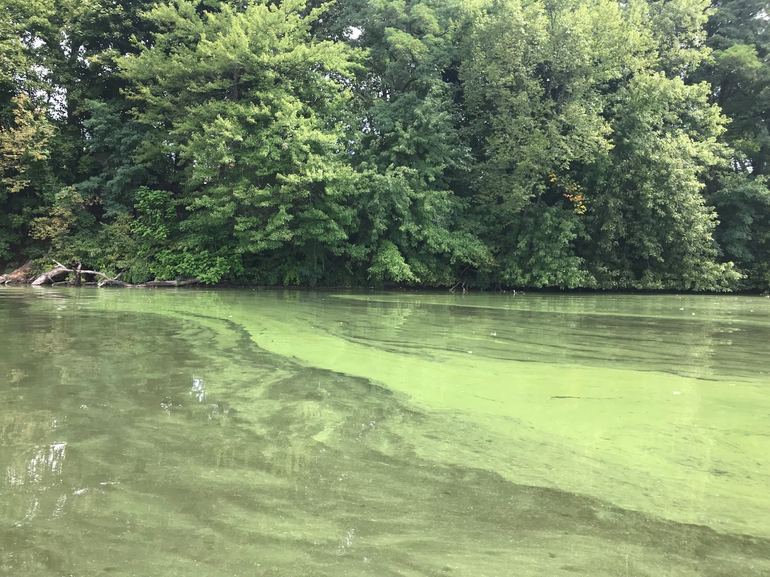
Introduction – Implications of Warming
Increasing temperature will affect both abiotic and biotic components of ecosystems
Warmer lake temperatures will likely cause cyanobacterial blooms to increase
Accurate lake temperature forecasting will be needed to protect human and environmental health

Slide 4
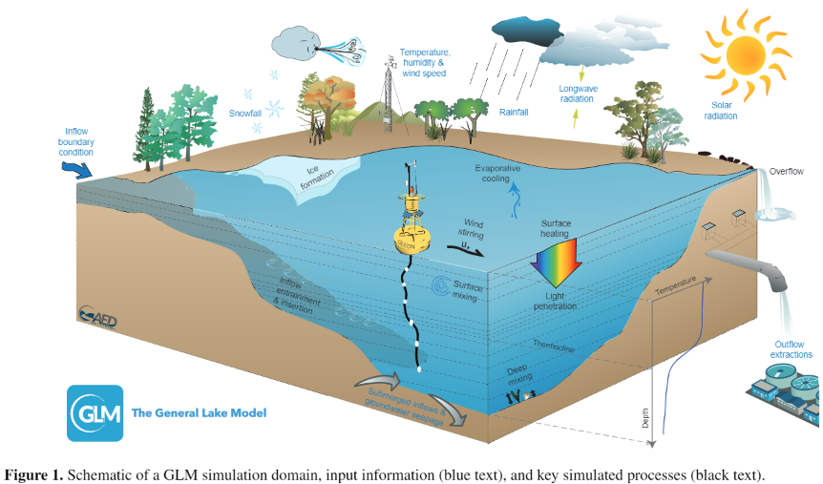
Previous Modeling Efforts
Most studies use single or small number of lakes
Models can be complex
Many of these studies yielded good results
Small lakes may be underrepresented
Hipsey et al. 2019. A General Lake Model (GLM 3.0) for linking with high-frequency sensor data from the Global Lake Ecological Observatory Network (GLEON). Geosci. Model Dev. 12:473-523.

Slide 5
Project Goals
To develop a simple, robust photic zone temperature model for all lakes in the conterminous US
To create a data product of continental scale air temperatures from PRISM and make the product and all R code publicly available

Slide 6
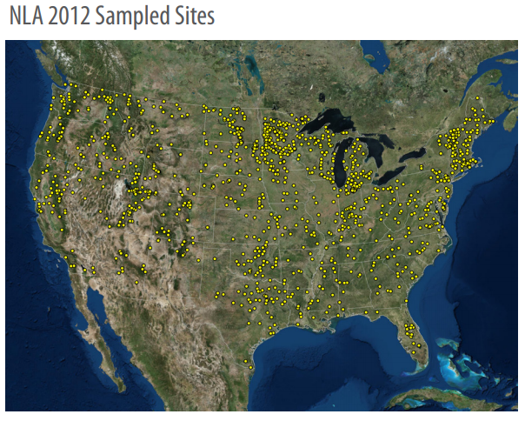
Methods – Water Temperature from NLA
2007 and 2012 NLA used
Over 1000 lakes across the conterminous US excluding the Great Lakes
Mean temperature for all sampled depths less than 2m
Small lakes well represented

Slide 7
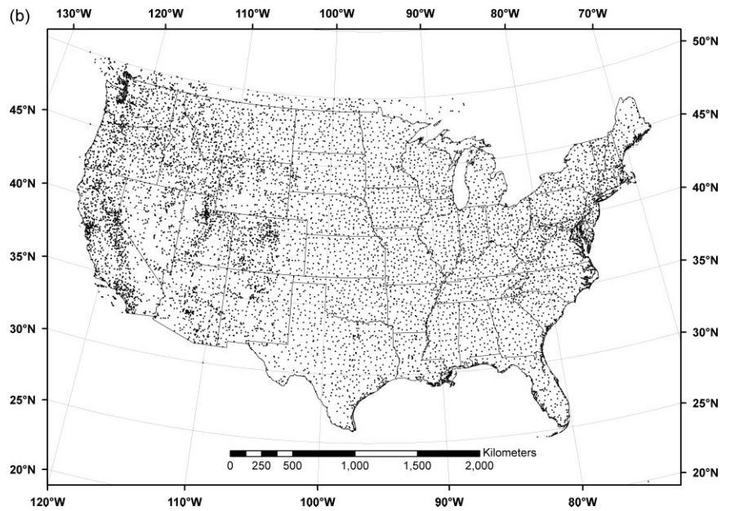
Methods – Air Temperature from PRISM
Daily temperature estimates (4 km grids)
1981-present
prism R package used to download mean daily temperature for centroids of NLA lakes
Temperature variables for model (day of, day before, 3, 7, and 30 days prior to NLA sampling date)
Daly et al. 2008. Physiographically sensitive mapping of climatological temperature and precipitation across the conterminous United States. Int. J. Climatol. 28:2031-2064

Slide 8
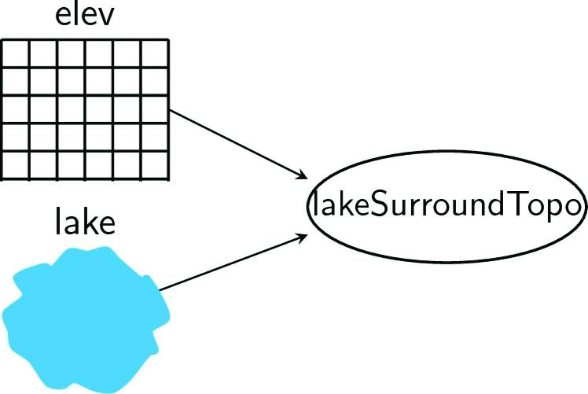
Methods – Other Variables
Other variables impact lake temperature (e.g., land use, lake depth, size, and elevation)
lakemorpho and elevatr R packages used to incorporate these variables
Landcover data from National Land Cover Database (NLCD)

Slide 9
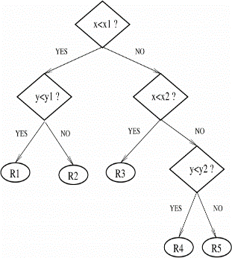
Methods – Random Forest
Random Forests
Machine Learning Approach
Based on trees
Classification
Regression
Very few assumptions
Predictions
Accurate
Less biased
Used to predict:
Chlorophyll a
Trophic state
https://www.otexts.org/1512

Slide 10
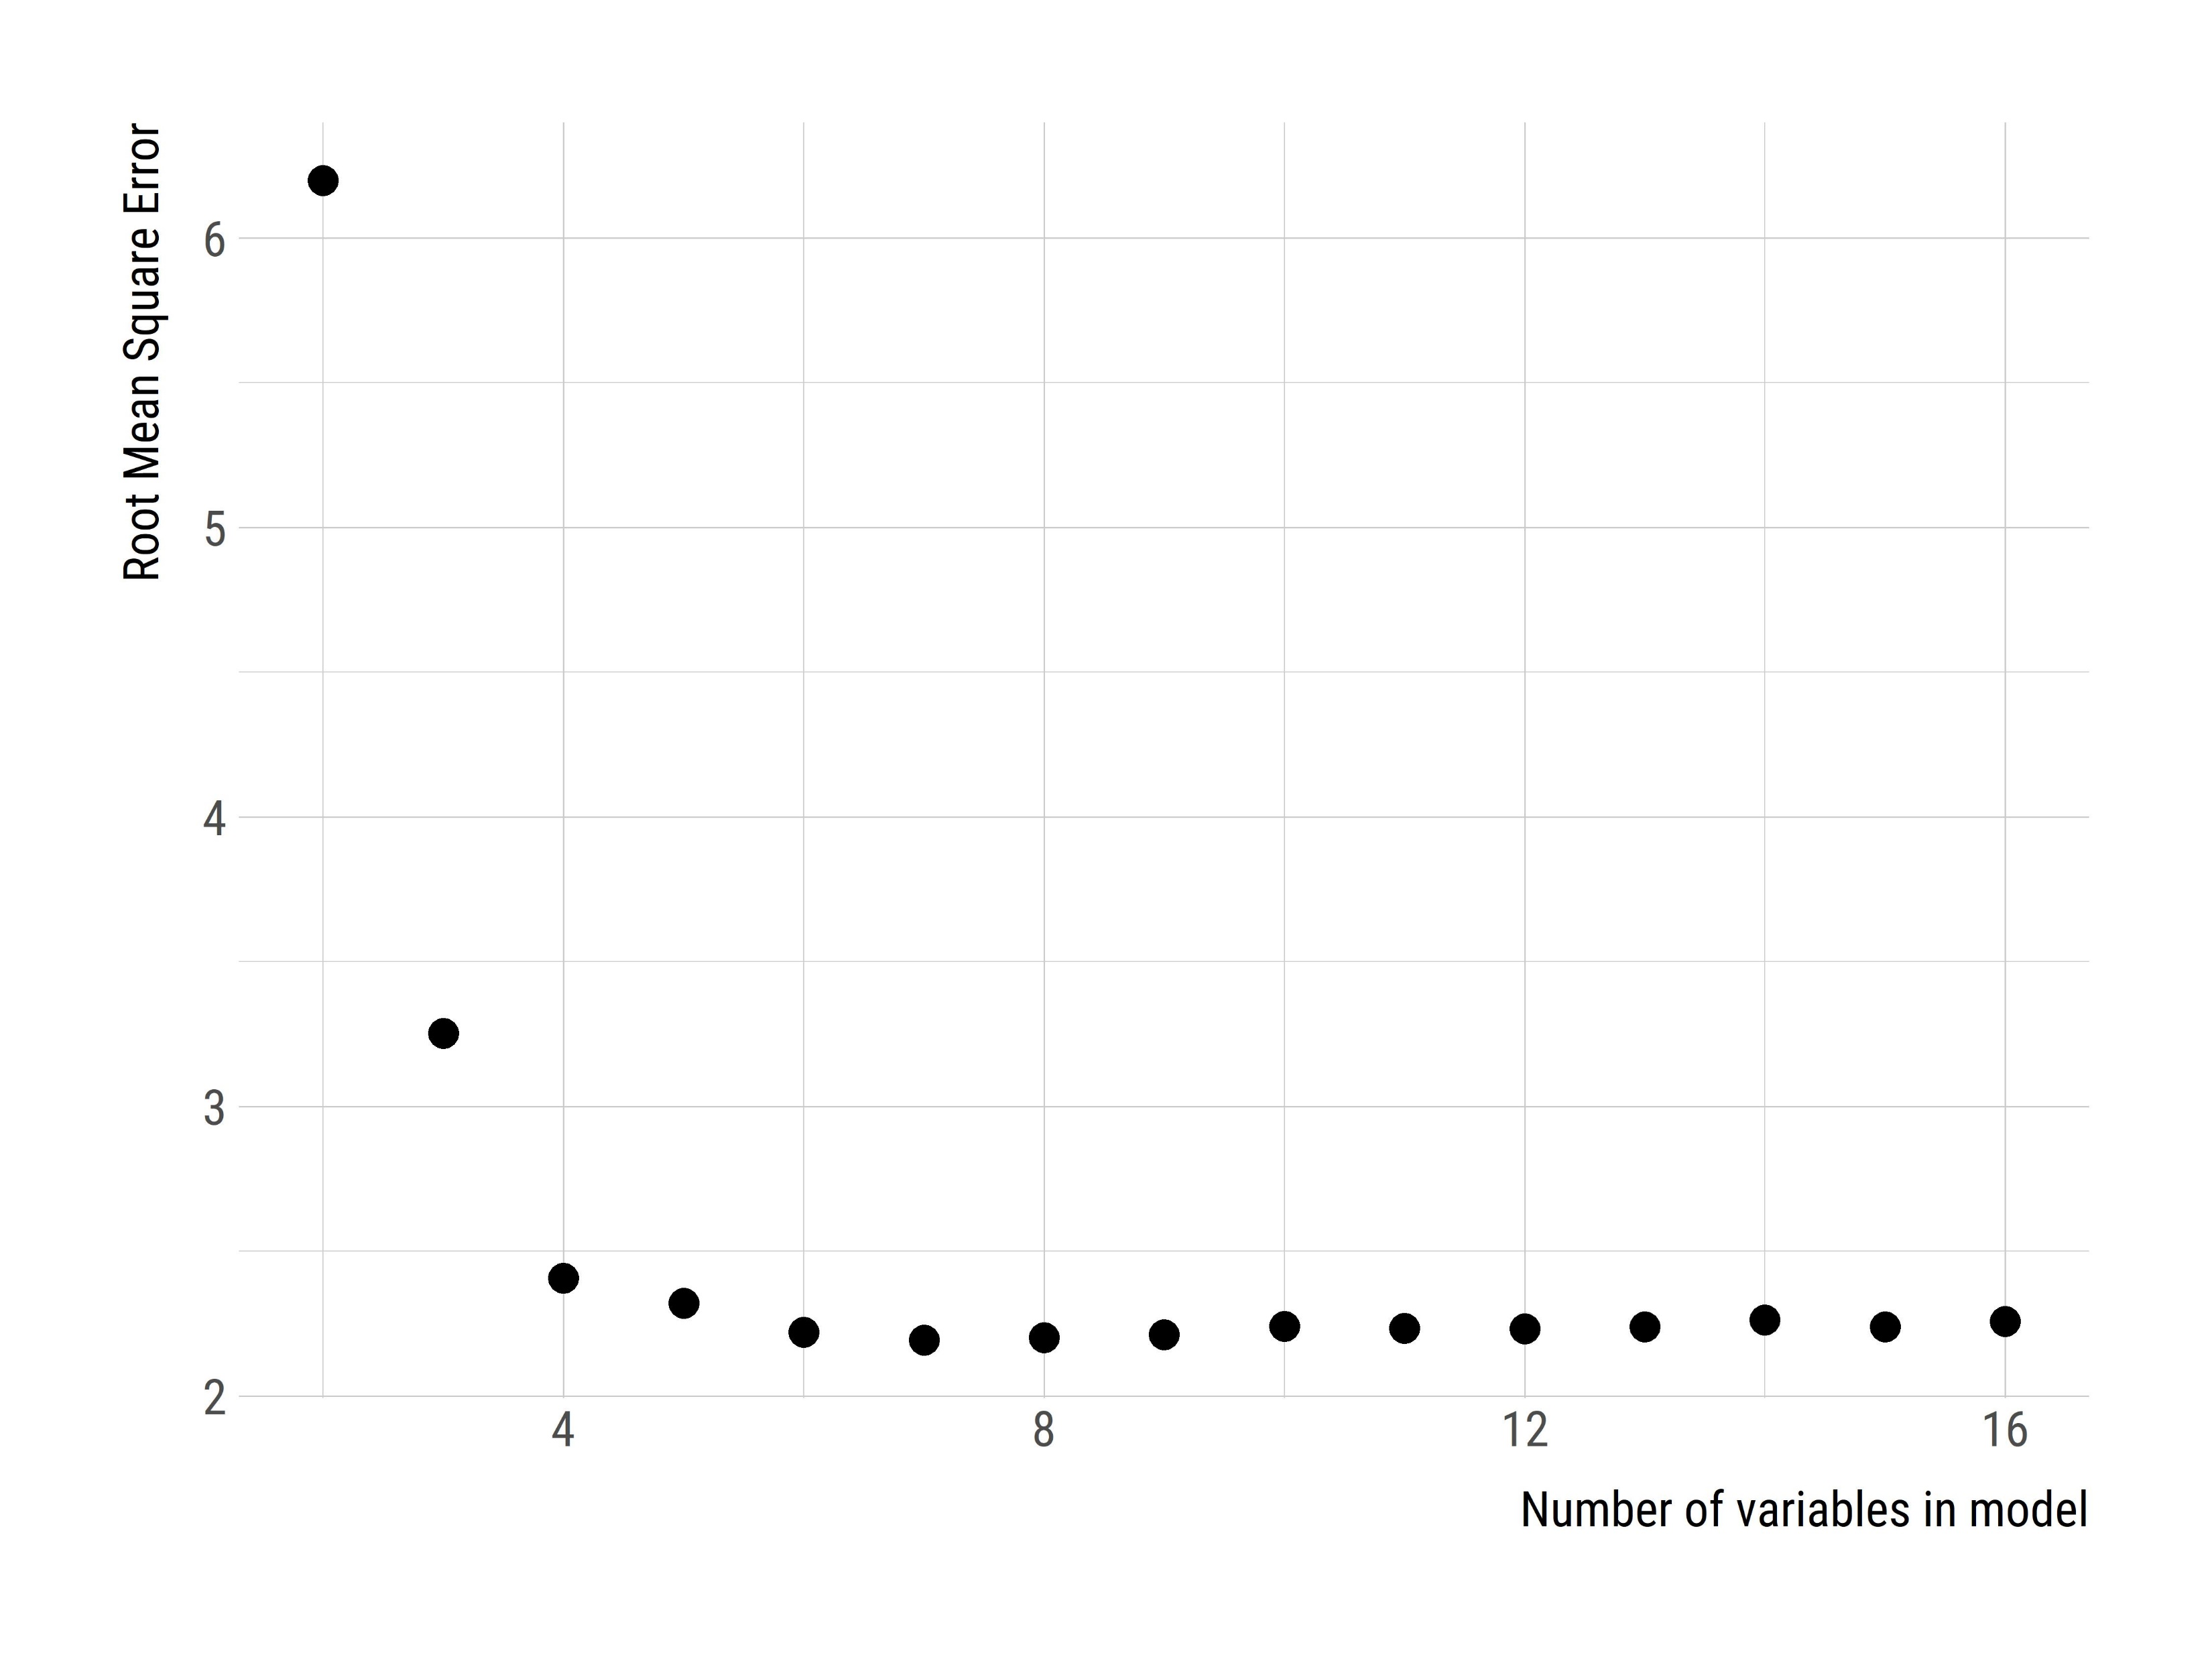
Results – Variable Selection
Average photic zone temperature was response variable
Began with 16 predictor variables
Variable selection identified 8 variables (avg. sample day temp, sample date, longitude, avg. 30 day prior temp., elevation, latitude, shoreline length, and lake surface area

Slide 11
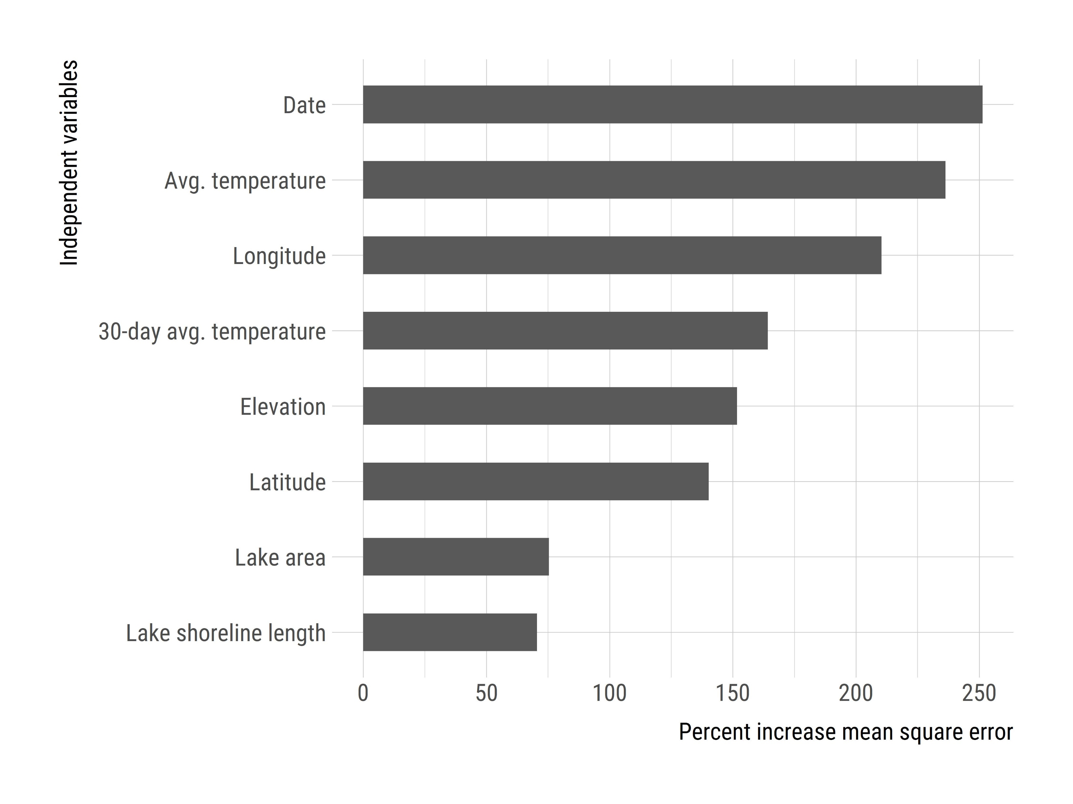
Results – Final model
Final model has mean-squared error of 2.19 °C and adjusted r² of 0.88
Variables ranked in order of importance: date, avg. temp., longitude, avg. 30 day temp, elevation, latitude, lake surface area, and shoreline length

Slide 12
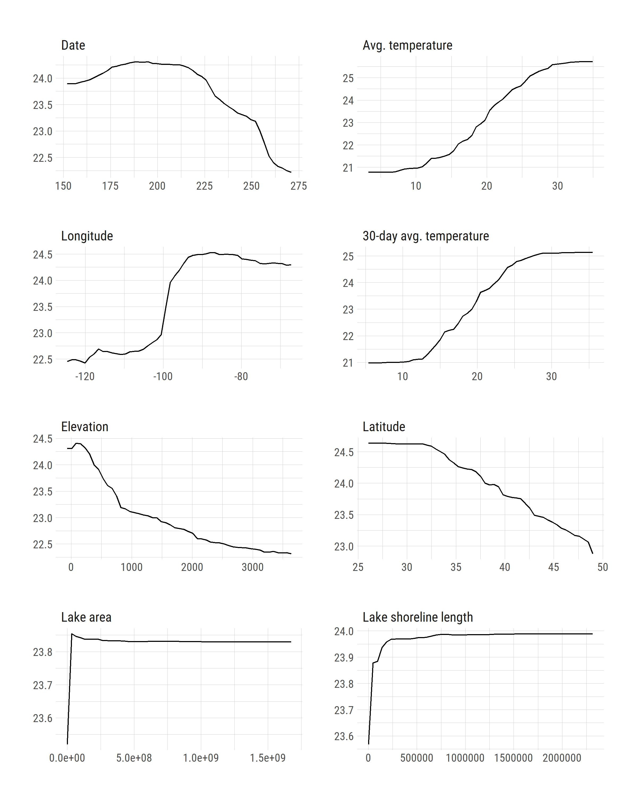
Results – Partial Dependency Plots

Slide 13
Conclusions and Future Work
A simple, yet robust, model was created capable of predicting photic zone temperature in any lake within the continental US
We are currently backcasting lake temperature for all lakes (>300,000) in NHDplus to investigate spatial and temporal trends (1981-2018)
Next, we plan on forecasting??

Slide 14
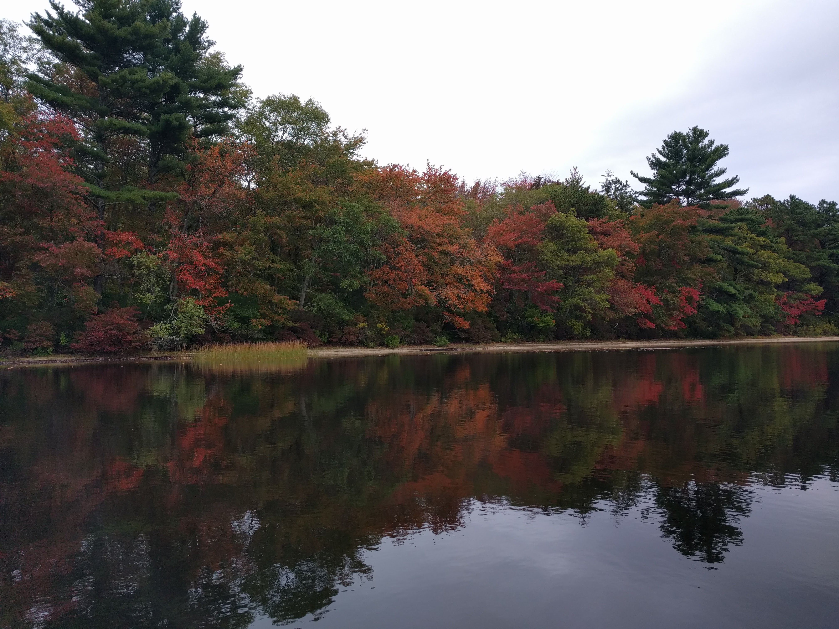
Questions?

